Slide 1

Module 1a- SOC-230 Social problems Norfolk state university Creating Strong Passwords: A Simple National Security Tool
Claude Turner, Ph.D., Carlene Turner, Ph.D.,

Slide 2
MODULE OBJECTIVES
At the end of the module, students will be able to:
Identify the parameters of secure passwords
Create efficient passwords - with or without a password manager;
Apply sociological theory to password creation behavior.
Explain how national security would be enhanced with efficient password protocols.

Slide 3

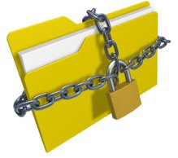
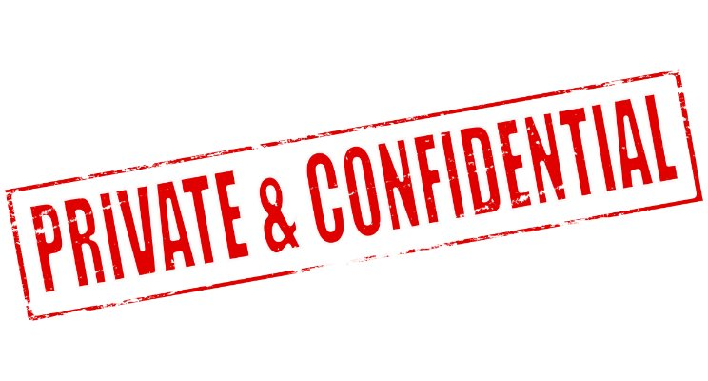
Background/lecture information
Summary:
A major tenet of Sociology is that “researchers must safeguard the participants’ right to privacy and dignity while protecting them from harm” (1).
Sociologists also believe that confidential handling and protection of information is also a contemporary social problem for national security practitioners in the USA (2)
Sociologists and Cybersecurity specialists essentially approach confidentiality in a similar way.
In Cybersecurity, confidentiality, integrity and availability are the three major pillars of the discipline; often referred to as the CIA triangle.
Notes:
Kendall, Pg. 34
Eitzen, Bacca Zinn & Eitzen Smith

Slide 4
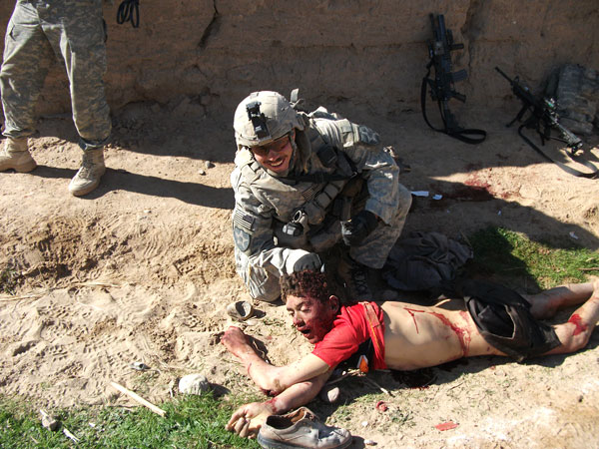
Example of Occurrence

Slide 5
Sociological Theoretical Explanation – Rational Choice Theory
Sociologist Gary Becker’s Rational Choice Theory can be used to explain everyday decisions about password creation.
People are naturally rational beings. Rational thinking influenced certain decisions or behaviors.
People make decisions based on a calculated cost-benefit analysis (“What do I gain and/or lose from a specific action?”)” (1).
An individual would be more inclined to commit or implement actions for self-interest.
Are people driven to choose an effective passwords to protect themselves and their environment?
National security practitioners should be aware of the damaging costs unsecure passwords can have, and this should impact how they create passwords.
Lay people as well as security personnel should be aware of the costs if passwords are unsecure.
Notes:
(1) Kendall, 2014

Slide 6
Description:
A password is an authentication mechanism used to verify that a user is the legitimate owner of a user ID.
Cybersecurity as a national security social problem:
During the Obama administration, there was a White House Comprehensive national Cybersecurity Initiative (https://www.whitehouse.gov/issues/foreign-policy/cybersecurity/national-initiative)
The initiative identified cybersecurity as one of the most serious national security challenge we face as a nation.
Sociologists also point out that cybersecurity vulnerabilities have been identified as a national security social problem primarily because (1).
The cyber border is probably the most porous border in the United States.
Notes:
(1) “the United States, in particular, is relatively unprotected from terrorist attacks because it is a mobile, open society with porous borders that are difficult to police” (Eitzen, Bacca Zinn and Eitzen Smith Pg. 470)

Slide 7
PASSWORD PRINCIPLES – How can a password be compromised?
Example of Occurrence:
January 4th, 2009, a hacker known only as GMZ, launched a dictionary attack against the account of a Twitter user named Crystal.
The program ran for several hours overnight
GMZ soon realized that Crystal was actually a Twitter staffer with administrative privileges.
S(He) reset the administrator’s password and shared it with fellow hackers. Some of the accounts compromised included: President Elect Barack Obama, Britney Spears, CBS News and Fox News.
Weak Password Brings 'Happiness' to Twitter Hacker http://blog.wired.com/27bstroke6/2009/01/professed-twitt.html
Easily guessed password are easy target for brute force and dictionary attacks. Examples - your user ID, any name, or a word from the dictionary;.
If you use a strong password but write it down and stick it to your monitor, place it under your mouse pad, and so on; it could be stolen.

Slide 8
Strength Rules
Password Rules
●S1: Length:
Password policies typically require a length of at least 6 to 8 characters. There is considerable variability, where some organizations may require a shorter length (e.g., a 4-digit PIN) while others enforce longer passwords (e.g., at least 8, 12 or 15 characters or an exact length). A password length policy prevents users from choosing passwords that are too short.
●S2: Composition:
It enforces rules about what types of characters can be used. A password composition policy typically require passwords that contain characters from one or more of the following sets:
○ Uppercase characters
○ Lowercase characters
○ Base 10 digits
○ Non-alphanumeric ASCII characters
A password composition policy prevents users from choosing passwords that are too simple.
●S3: Blacklist:
Some organizations prohibit the use of dictionary words due to the susceptibility of human-chosen passwords to dictionary password guessing attacks. Others enforce this rule by banning the use of the most common passwords. For example, users could be banned from choosing passwords from a blacklist of the top 1000 frequently used passwords. Typically, lists of the most commonly used passwords are obtained from leaked datasets (e.g., RockYou).
Password rules have evolved since their inception, the most commonly used passwords fall into two broad categories:
Strength rules are important during the password creation process.
Management rules become important after passwords are created.
The password rules we adopt for this module are derived from their use in practice as discussed by Zhang-Kennedy et al.

Slide 9
Management Rules
M1: Change-it-often: requires users to change their passwords at a set interval (e.g. 90 days)
M2: Do-not-reuse: do not use the same password across multiple accounts; reusing passwords from weak sites could compromise security
M3: Do-not-write it down: intended to prevent local attacks from friends, co-workers, family, or other onsite observers
M4: Do-not-share-it-with-anyone: Users are advised to not share their passwords with anyone. The security reasons seem obvious, but user practice indicates that passwords are frequently shared with close family members and colleagues. Some security experts [10], [38] argue that password sharing may be appropriate under certain circumstances, such as during account recovery or in an emergency situation.

Slide 10
Updated Password Rules
Updated M1 – Change-your-password-well: If you suspect that a service has been compromised change your password.
M1 (change-it-often) is not recommended (1). It provides minimal protection against access to an account by an attacker. Users tend to make simple modifications (e.g., password1, password2, password3).
Updated M2 – Strategically-reuse-passwords: Categorize accounts based on their importance. Use unique passwords for high-value accounts (e.g., banking). Only reuse passwords for low-value accounts.
Updated M3 – Keep-written-down-passwords hidden: Store written-down passwords or password hints in a secure place. The practice might be against the rules for some companies. Custodians and other workers might have access to a user’s office.
Updated M4 – Share-passwords-with-caution: Share passwords with family, friends, or colleagues with caution. Change your password when the sharing obligation ends.
Updated S1-S3 – Create-strong-and-memorable mnemonic-passwords:
Create strong and easy to remember passwords using original mnemonic phrases.
Should be at least 8 characters long and do not contain common passwords (e.g., ‘123456’, ‘password’), predictable character substitutions (e.g.,‘pa$$w0rd’.), or dictionary words
Notes:
(1) According to Zhang-Kennedy, forced password expiration causes extreme annoyance and fatigue for users and has few security benefits.

Slide 11

There are no foolproof methods to construct and keep passwords 100% private/safe. There are a variety of methods to construct the most efficient passwords.
The Problem

Slide 12
An Example Password Algorithm/Scheme
Mnemonic-based passwords are strongly recommend using (1).
For example, the first letter from each word of a memorable phrase is selected as the password.
Mnemonic-based passwords are as memorable but are as difficult to guess as randomly chosen passwords (2).
Users should avoid selecting common phrases
Building a comprehensive mnemonic dictionary is non-trivial due to the large search space of possible phrases.
This has a lower success rates and less commonly deployed by attackers than regular dictionary attacks.
The following are the steps:
Select a memorable phrase (not too common)
Take the first letter of every word in the sentence, and include the punctuation; Throw in extra punctuation or
Change numbers into digits for variety.
Here are some examples:
Password | How to remember it
Mrci7yo! | My rusty car is 7 years old!
2emBp,1ib | 2 elephants make bad pets, 1 is better
ItMc?Gib | Is that MY coat? Give it back.
Notes:
(1) Yan et. al.

Slide 13
How to determine the strength of your password?
A partial list of to determine the strength of passwords:
Memorability check: Can you remember it?
Length check: Is it at least eight characters long. Longer=Stronger. Windows XP allows up to 127 characters
Alphanumeric character check: Does it include both letters and numbers
Upper- and lower-case letters check: Does it include both upper and lowercase letters
Punctuation and non-alphanumeric character check: Does it include one or more characters, such as #, $, !, @ and punctuation marks, such as the period and comma.
Dictionary Check

Slide 15
LAB Complete the following lab exercise as directed by your instructor: 1.Create three passwords different from those given. For each password, provide the corresponding sentence that you would use to remember it.
Security checklist
Vulnerability | Weak Password |  | Course | SOC-230
For each password, decide whether following criteria are met: |  | Yes/No - describe |  |  | N/A
Is the password at least 8 characters long? |  | Yes
Check memorability |  | Yes
Check alphanumeric |  | No
Check upper/lower case |  | Yes
Check punctuation and/or other non-alphanumeric characters |  | Yes
If you answered no to any of the above questions, then your password is weak.

Slide 16
Continued…
Using the checklist above, complete a checklist for each (password, password hint) pair below. Also list any problems.
a. ( Ihtk:JaJ “I have two kids: Jack and Jill” )
b. ( 2BontBtitq! “To be or not to be, that is the question” )
Password Checker: Use Password Checker to verify whether your passwords are strong enough. Password Checker is a Microsoft tool and is available at: https://www.microsoft.com/en-us/security/default.aspx
Evaluate the given passwords manually against the security checklist to see whether it meets the criteria described by the checklist.
a. Password1!
b. OmN;Gmj1mn

Slide 17
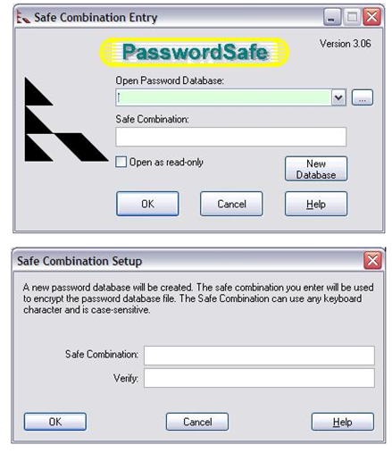
Continued…
5. Password Managers: It is challenging to remember many passwords.
Password managers provide a means of managing multiple passwords.
A popular Password Manager:
PasswordSafe (by Bruce Schneier). It is freely available at https://pwsafe.org/.
6. Complete the following tasks:
Create the following four user accounts, hclinton, dtrump, bsanders and bcarson
Generate passwords for each of the account. The passwords should vary in length. Specifically the lengths should be 12, 14, 16 and 20 respectively, and consist of numbers, upper-case and lower-case letters, and special characters.

Slide 18
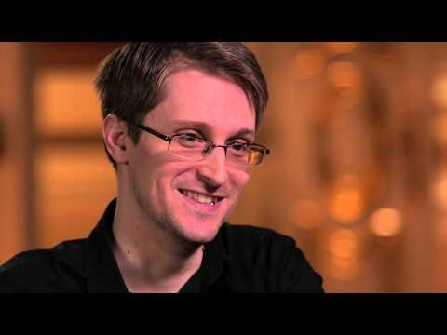
Cracking Passwords: Edward Snowden on secure passwords

Slide 19

DISCUSSION QUESTIONs
1) If a longer password is more secure, why not just use the entire sentence instead of picking the first letter of each word?
2) How can strong passwords contribute to national security efforts?

Slide 20

WORK CITED
Eitzen, D. Stanley, Maxine Bacca Zinn and Kelly Eitzen Smith. Social Problems. Boston: Pearson, 2014.
Kendall, Diana. Sociology in Our Times: The Essentials, 10th Edition. Boston: Cengage Learning, 2016.
NISTIR 7991 (2014). United States Federal Employees’ Password Management Behaviors – a Department of Commerce Case Study.
The Comprehensive National Security Initiative. Retrieved from: https://www.whitehouse.gov/issues/foreign-policy/cybersecurity/national-initiative
Zetter, Kim. Weak Passwords Brings ‘Happiness’ to Twitter Hacker.Security, 2009
http://blog.wired.com/27bstroke6/2009/01/professed-twitt.html
Websites:
http://nvlpubs.nist.gov/nistpubs/ir/2014/NIST.IR.7991.pdf
http://www.cdse.edu/documents/toolkits-issm/ODAA_Baseline_Security_Config.pdf

Slide 21
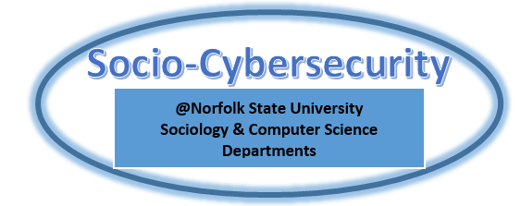

acknowledgement
NSF Award No. 1623201 “Targeted Infusion Project: Security Pedagogy Across the Curriculum: A Model to Integrate Cybersecurity into the Social Science

